Slide 1

GEIQ: Final Project
Rodrigo Pérez Gopar
Jacobo Rayek Tuachi
Rafael Correa Engelhardt

Slide 2
Problem:
Blade type ABC123 was found to be deteriorated before the expected lifespan for engine EX-50.
EX-50 engine in its two versions, EX-50A and EX-50B, flies with NU-432 type of aircraft which has five main customers, French Air (FAR), Desert Middle East Airlines (DME), Asia United Air (ASI), American Citizen Cargo (ACC) and Samba Linhas Aereas (SLA).
Two million records have been retrieved for a sample of engines which Engineering experts have found to be relevant to the analysis.

Slide 3
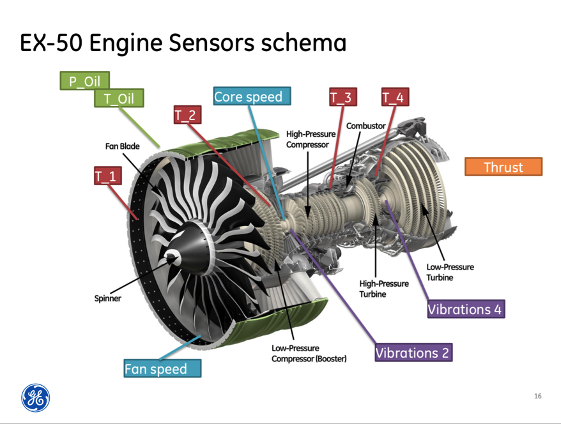
Engine

Slide 4
Objective
The main objective of the project is to create an analytical model or algorithm that predicts the engine deterioration and with it the status of the engine (failed, non-failed). With the data set given we tried to found this model, so that afterwards it can be applied to a new data set and predict the failures of the engines.

Slide 5
Data Cleansing
We analyzed how many rows were present, which variables and parameters were taken into account and their type of data (object, float, int).
As we were starting this analysis we noticed that each row was a flight.
As we started with the data cleansing, we focused first in eliminating all the rows that had strings or invalid data, and the parameters that were out of range.
As we identified different data types, we transformed all the numeric data types to floats with the intention of having the ability to work freely with all the data.
At the end of the cleansing we accomplished to remove 174,164 rows.

Slide 6
Data Pre-processing
We aggregated the data by engine_id by computing the mean of each parameter. Each of the engine_id’s has an specific customer, an specific engine_type and a specific damage measure.
We calculated how many flights has done each engine and included in the aggregated data.

Slide 7
Data Pre-processing
By aggregating the data by engine_id by computing the mean of each parameter we found 400 different engine id’s each one with the mean parameters of each engine (we were able to reduce the database to only 400 rows).
Then, we summed up the flight id’s for each engine and included it to the aggregated data set. Also, we were able to see that there are 7720 different flight_id`s, or plane routes.
We also converted the category (failed, not-failed) to binary (1,0). And transformed the new data set to a brand new csv.

Slide 8
Exploratory Analysis
With all the cleansed data and it being aggregated with the mean of each parameter, we wanted to understand completely the data given to us.
First we identified that of the 7720 different flight id’s given their were only 400 engine_id’s.
Of this 400, it was divided into two different engine_types.
engine_type
EX-50A 160
EX-50B 240

Slide 9
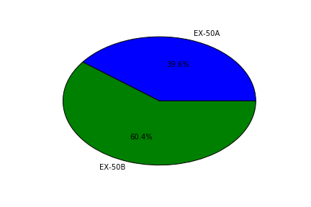
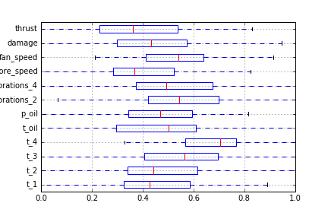
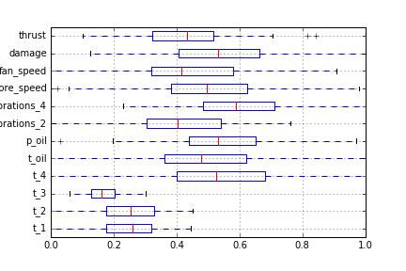
Exploratory Analysis
We made a pie chart to show this relation:
We created box plots by customers for each of the variables. This allowed us to visualize the behavior for each variable for all the customers.
ACC FAR:

Slide 10
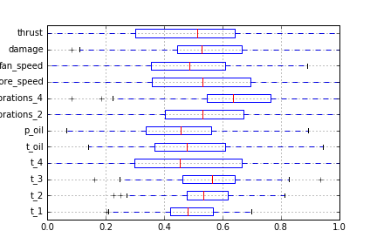
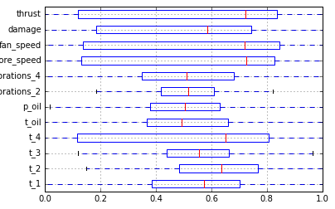
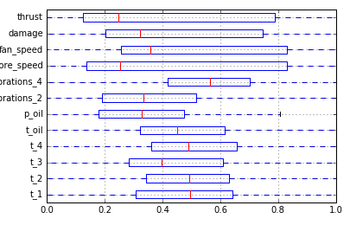
Exploratory Analysis
SLA: DME: ASI:

Slide 11
Exploratory Analysis
We can see that for DME the thrust, damage and speeds are accumulated to the right of the box plot. Whereas for ASI, the first four variables are accumulated to the left of the box plot.
These irregularities do not appear with the other customers, so for each customer, we calculated the mean of the damage.

Slide 12
Exploratory Analysis
customer damage
ACC 25.403729
ASI 44.974294
DME 48.189059
FAR 25.533029
SLA 23.638572

Slide 13
Exploratory Analysis
With this results, we identified that the customer ASI and DME were the ones that maintained the highest mean damage. So we focused in this two customers to evaluate the engines that failed.
We found that of the total engine’s, 78 were the ones that failed. Of the 78 engines, 42 belong to the Dessert Middle East airlines, and their engine type is EX-50A, the rest, that are 36 engines belong to the Asia United Air and their engine type is EX-50B.
Even though there is a bigger percentage of engine type EX-50B only 15% were the ones that failed, in comparison with engine type EX-50A in which 26.3% failed.

Slide 14
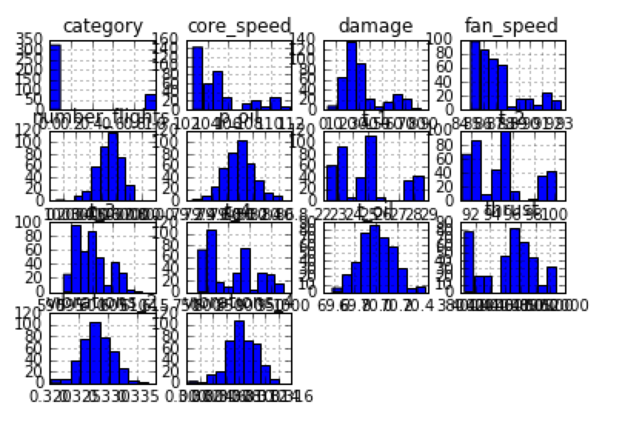
Data Visualization
To identify data trends and understand the behavior of the data, we generated different type of plots.

Slide 15
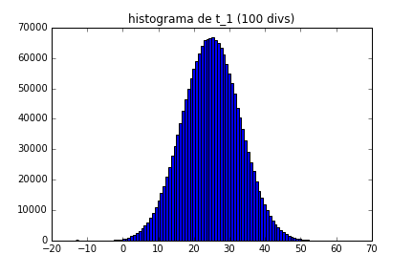
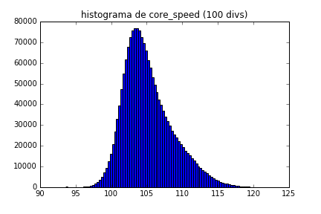
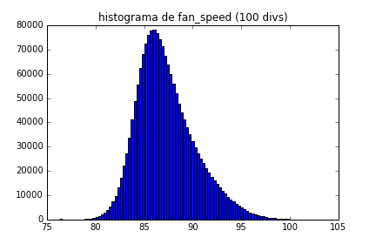
Data Visualization
First we created histograms of all the variables, this assured us that the data we are working with follows a normal distribution:

Slide 16
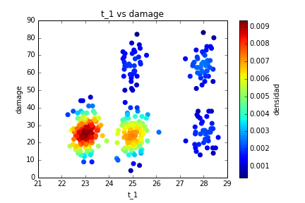
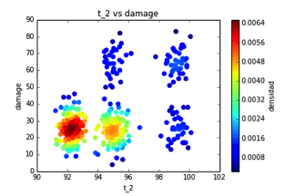
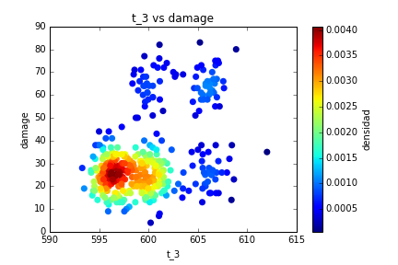
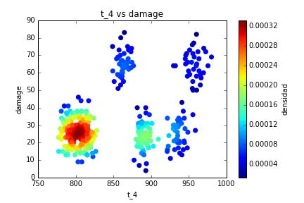
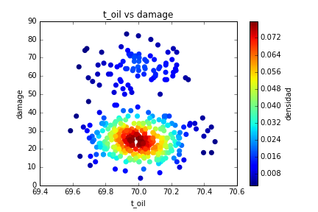
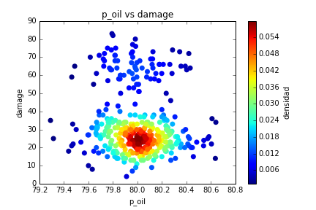
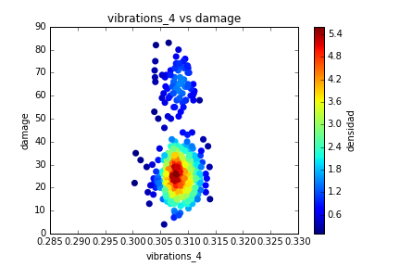
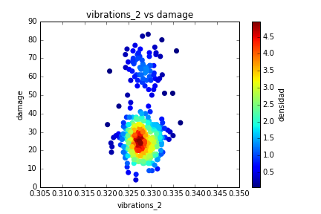
Data Visualization- Heat Maps
Next, we generated heat maps and scatter plots to compare and evaluate the the behavior of each variable. We plotted each variable against the damage.

Slide 17
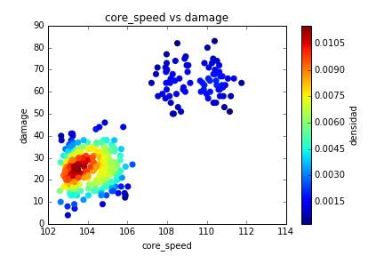
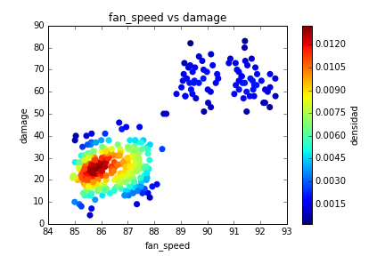
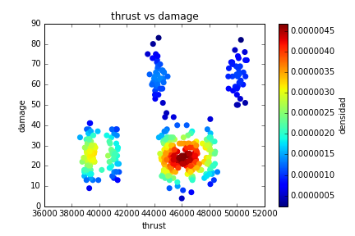
Data Visualization- Heat Maps
The heat maps showed us what we already expected. That the accumulation of the data is located where the engines didn’t fail. It also allowed us to see some irregularities that will show better in scatter plots.

Slide 18
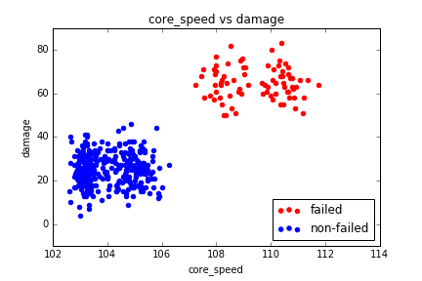
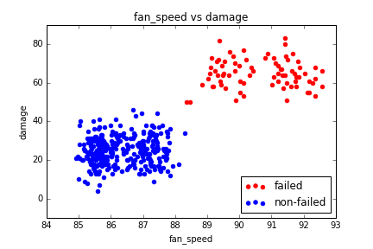
Data Visualization- Scatter plots
By visualizing the plots we can assure that after a specific value of fan speed and core speed the engine begins to fail. Also, we can identify which engines are going to be the next to fail, in other words which ones are near to this specific value.

Slide 19
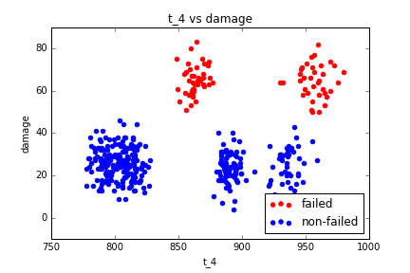
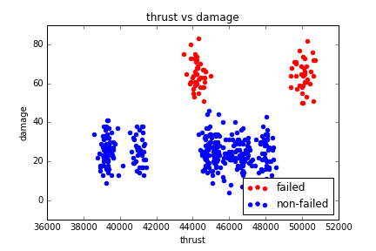
Data Visualization- Scatter plots
We can also observe some irregularities in the t_4 and in the thrust, where there is a specific range in which it fails and after a specific value it also starts to fail.

Slide 20
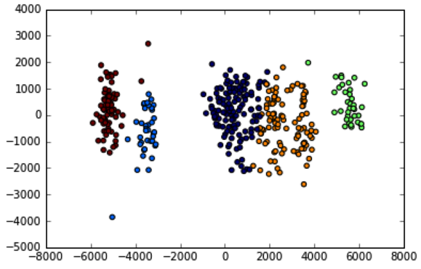
Data Clustering- K-mean
With the scatter plots and the clustering, we observed there’s a relationship between the clusters and the categorical (discrete) variables, like fan_speed or core_speed, like we mentioned above. When the fan_speed goes over 88, engines fail. When core_speed goes over 107, engines fail.

Slide 21
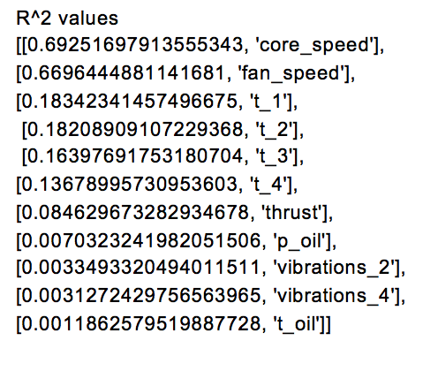
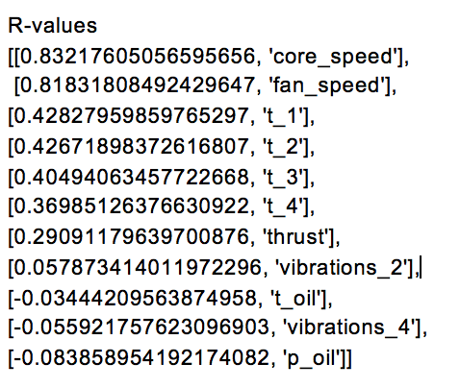
Correlation and Variable Selection
Computed correlation matrix and a R-squared values for all variables. We established the Y as damage and the X’s as all the other variables.
So after all the analysis done, we can declare that the variables that affect the status of the engine are the core speed, the fan speed, and the t_1.

Slide 22
Data Classification and regression Models
We created a multivariate regression model, a binary logistic regression model and a KNN model in order to compare which model is the best and use it to predict and prevent future engine failure. The best model should give better predictions we will then evaluate in a confusion matrix to see the accuracy of the model:
[(total predictions - mistakes)/ total predictions]
The features we used for the models were core_speed and fan_speed, since those are the most significant variables and introducing other variables into the model only made it weaker.

Slide 23
Multivariate Regression Model
It is a simple model, it compares the points between the independent variables x and the dependent variable y, adjusting the points to a line. In the predictions, if the y value was above 50, the engine is considered as failed (1).
Confusion matrix:
[[339 17]
[ 17 95]]
Precision: 98.071454%
There are 17 false positives and 17 false negatives, the model is not perfect.
yi = β1xi1 + β2xi2 + · · · + βk xik + ei

Slide 24
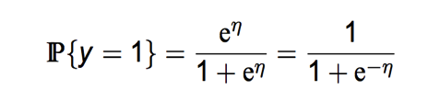
Logistic Regression Model
Similar to the linear model, but the dependent variable is a categorical one (it’s value is 1 or 0), so it predicts directly if the engine is going to fail or not.
Confusion matrix:
[[183 139]
[ 3 75]]
Precision: 64.473577%
There are 3 false positives and 139 false negatives, the model is generally bad, the multivariate regression model is still a better one.

Slide 25
KNN model
The kNN algorithm is a non-parametric algorithm that can be used for either classification or regression. For each data point, the algorithm finds the k closest observations, and then classifies the data point to the majority.
Confusion matrix:
[[322 0]
[ 0 78]]
Precision: 100.000000%
There are no false positives or negatives, just true vales. This model is the best one, as it predict with 100% precision.

Slide 26
Prediction
The final step was to add the steps we need for a new dataset (like cleansing) in order to predict a new dataset we are going to be given, and we are going to predict if the engine failed or not by using the models we just described.

Slide 27
Data Cleansing
We removed almost 200,000 rows of invalid data
Aggregating the data
By computing the mean of each parameter by engine id.
Plots
The histograms made us realize that the distribution of the key variables was a normal one. The heat maps and scatter plots helped us seeing which variables could be scattered
We created a multivariate regression model, a binary logistic regression model and a KNN model in order to compare which model is the best and use it to predict and prevent future engine failure.
The variables that affect the status of the engine are the core speed, the fan speed, and the t_1.
Correlation Matrix
Regression Models

Slide 28

Conclusion
Data science is an extremely interesting and useful topic, we would never have imagined at the beginning of the semester that we would be able to work with a database of more than a million rows, clean it, analyze it through different statistical tools, and end up with three different prediction models that will help in the prediction of whether an engine is going to fail soon or not.

